Slide 1

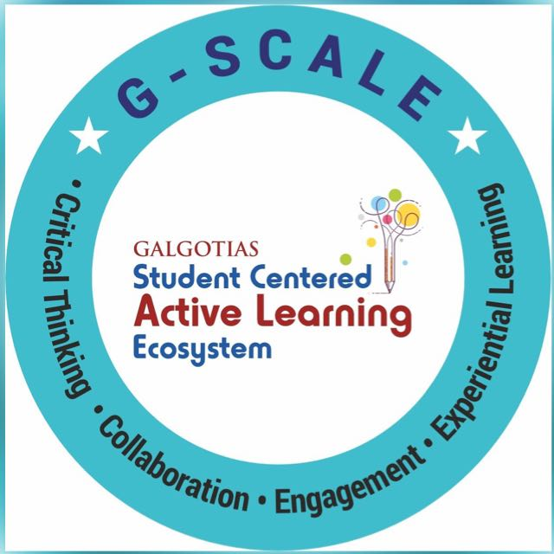
A Model for Network Security Session No.: 01 Course Name : Fundamental Of Cyber Security Instructor Name: Duration: 50 minutes Date of Conduction of Class:

Slide 2
Opening Question
If you send a password over the internet, how can you be sure no one else is reading it?
What would happen if someone intercepted your online banking password while you were logging in?
Can you think of a time when you received a suspicious email or link? How did you know it was unsafe?”

Slide 3
At the end of this session students will be able to
Learning Outcome 1: Analyze real-world networking scenarios to identify potential security threats.
Learning Outcome 2: Identify basic defensive mechanisms for particular threats.

Slide 4
Session Outline
1 Introduction to Network Security
2 Threats and Challenges
3 Security Mechanisms
4 Hands-on Activities
5 Reflection
6 Summary

Slide 5
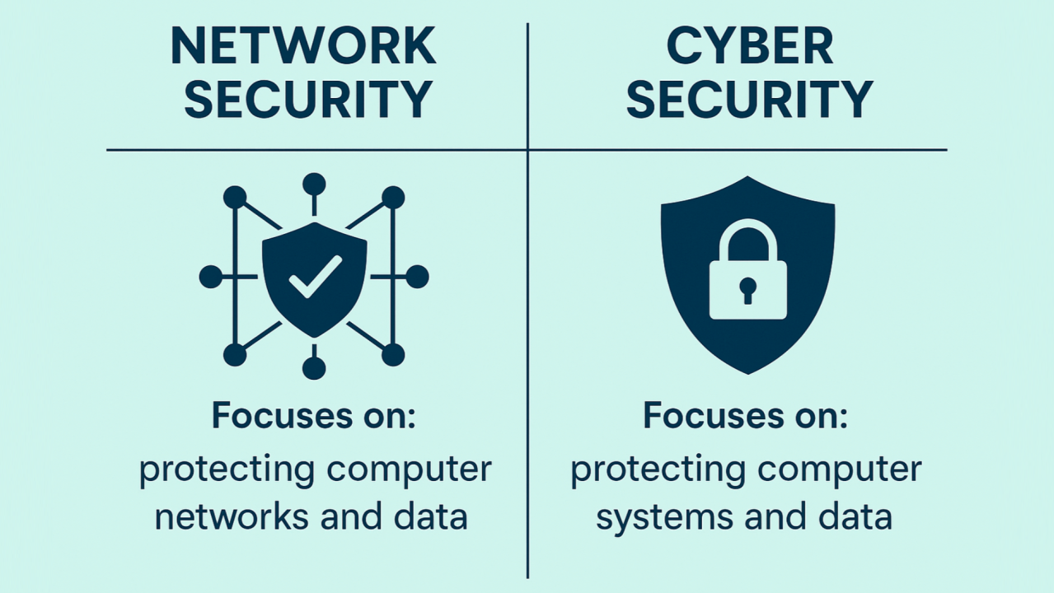
What is Network Security?
Definition: It is the practice of protecting the integrity, confidentiality, and availability of computer networks and the data transmitted over them.
Importance: Ensures privacy, data integrity, and trust in communication.
It involves measures to safeguard against:
Unauthorized access (e.g., hackers, intruders)
Misuse or theft of data
Attacks such as viruses, malware, phishing, DoS/DDoS
Disruptions to services

Slide 6
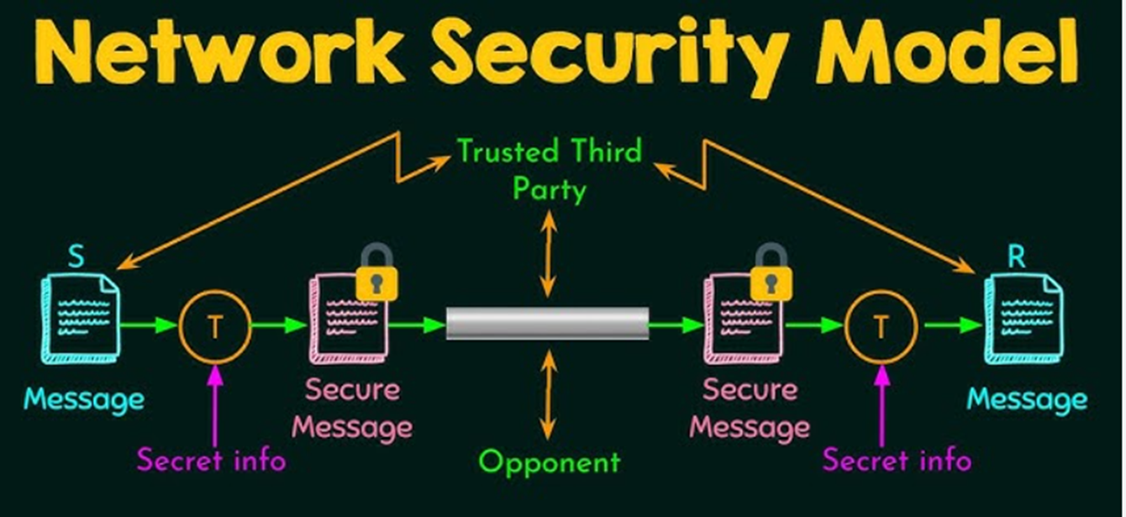
WhatsApp Message over the Network

Slide 7
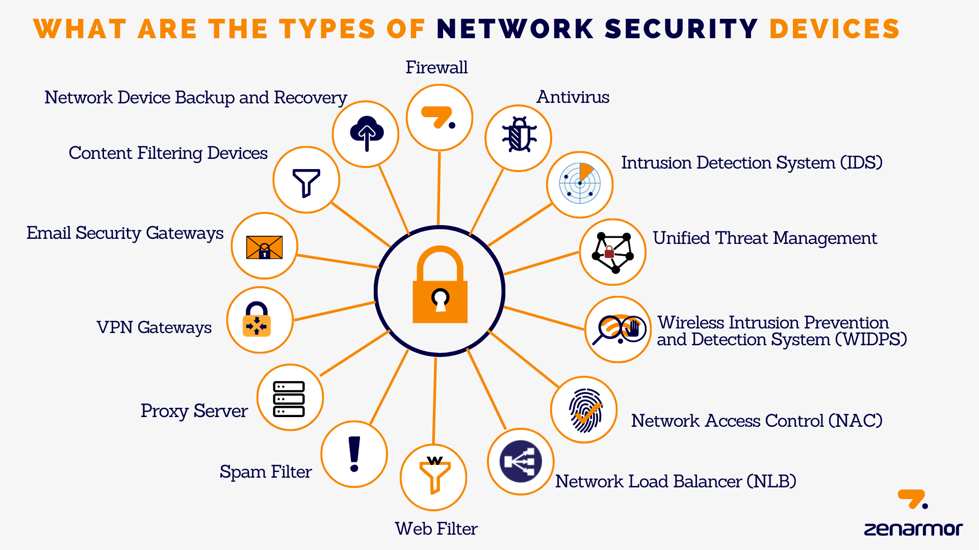

Slide 8
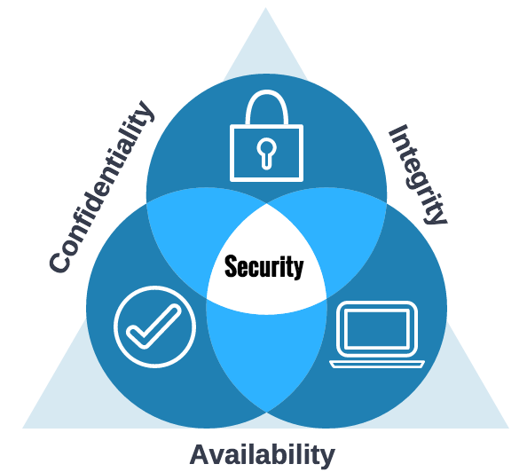
Goals of Network Security (CIA Triads)
1. Confidentiality 🔒 Ensures that information is accessible only to authorized users.
Methods: encryption, access control, authentication.
2. Integrity ✅ Ensures that information is accurate, consistent, and protected from unauthorized modification.
Methods: hashing, checksums, version control.
3. Availability 🌐 Ensures that authorized users have reliable and timely access to information and resources.
Methods: redundancy, backups, disaster recovery planning.

Slide 9


Key Threats in Networking
• Malware
• Phishing
• Eavesdropping (unauthorized listening)
• Denial of Service (DoS) attacks
Attack
Exploit
Vulnerability

Slide 10
Security Challenges
Evolving Threat Landscape: Attackers constantly develop new malware, exploits, and attack methods, making it difficult for defenses to keep up.
Zero-Day Attacks: Exploiting unknown vulnerabilities before patches are available.
Advanced Persistent Threats (APTs): Long-term, targeted attacks aimed at stealing sensitive data without detection.
Insider Threats: Employees or contractors misusing their access intentionally or accidentally.
BYOD (Bring Your Own Device) & IoT: Security Personal and IoT devices connected to networks often lack proper security controls.
DDoS (Distributed Denial of Service) Attacks: Overloading a network with traffic to make services unavailable.
Compliance & Legal Issues: Organizations must meet regulatory requirements (GDPR, HIPAA, PCI-DSS, etc.).

Slide 11
Types of Security Measures
• Firewalls
• IDS/IPS
• VPNs
• Encryption

Slide 12
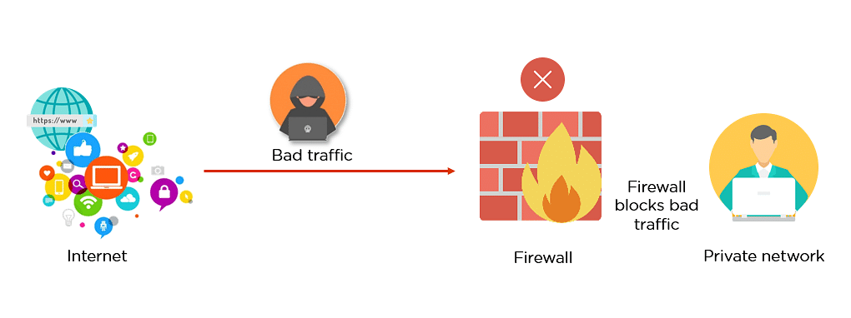
Firewalls
Definition: Filters incoming and outgoing traffic.
Types: Hardware and Software.
Role: Blocks unauthorized access.

Slide 13
Intrusion Detection/Prevention
1. Intrusion Detection System (IDS)
Purpose: Monitors network/system activities for malicious actions or policy violations.
Action: Only detects and alerts (does not block).
Analogy: Like a CCTV camera – it can see and record intrusions but cannot stop them.
Types:
Network-based IDS (NIDS): Monitors traffic on the network.
Host-based IDS (HIDS): Monitors activities on individual systems.
2. Intrusion Prevention System (IPS)
Purpose: Detects malicious activities and actively prevents them.
Action: Can block traffic, drop packets, or disconnect sessions.
Analogy: Like a security guard – it not only detects but also stops intruders.
IPS detects SQL injection attempt
IDS: Passive → Detects & Alerts.
IPS: Active → Detects & Blocks.

Slide 14
Virtual Private Networks (VPNs)
A VPN is a technology that creates a secure, encrypted connection (a “tunnel”) over a public network like the Internet. It allows users to send and receive data as if they were directly connected to a private network.
Remote Access VPN – For individuals connecting securely to a private network.
Site-to-Site VPN – Connects entire networks (e.g., between two offices).
When you connect to Wi-Fi in an airport and use a VPN → all your traffic is encrypted, preventing hackers from eavesdropping.
Analogy: A VPN is like a secret tunnel through the Internet that hides your data from prying eyes.

Slide 15
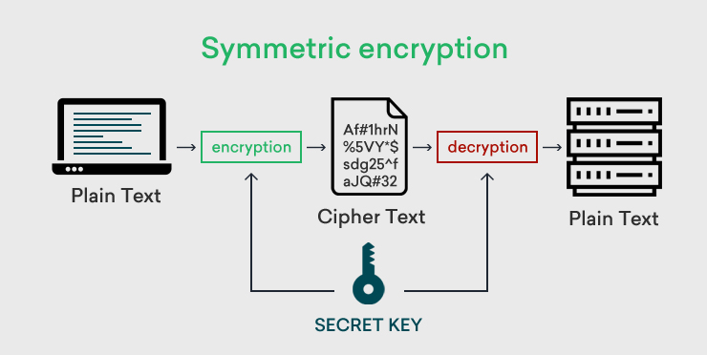
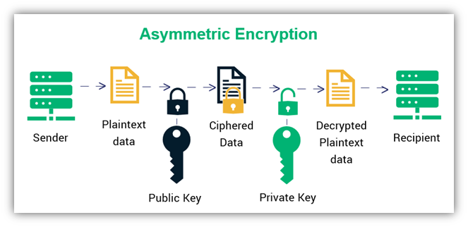
Encryption Basics
RSA, ECC, Diffie–Hellman Key Exchange, ElGamal Encryption
AES, DES, 3DES, Blowfish, RC4, ChaCha20

Slide 16
Authentication & Access Control
Methods: Passwords, Biometrics, Multi-Factor Authentication.
Goal: Ensure only authorized access.

Slide 17
Activity 1 – Think Pair Share
Task: In groups, identify threats in a campus Wi-Fi network.
Propose at least 2 security measures.
Share with class.

Slide 18
Activity 1 - Reflection
Teacher summarizes responses and connects to real-world practices.

Slide 19
Logging & Monitoring
Logging: recording events, activities, and transactions happening in a system or network.
Example:
Login attempts (successful & failed).
File access logs.
Firewall traffic logs.
Monitoring: continuous observation and analysis of logs or live data to detect suspicious behavior.
Example:
Detecting multiple failed login attempts (possible brute-force attack).
Identifying abnormal traffic spikes (possible DDoS).
Monitoring users accessing sensitive files outside office hours.

Slide 20
Incident Response Basics
Incident Response (IR) is the process of detecting, analyzing, and responding to security incidents (e.g., cyberattacks, malware outbreaks, data breaches) to minimize damage and restore operations quickly.
Phases of Incident Response (NIST model)
Preparation
Build an IR plan, train staff, deploy monitoring tools.
Example: Setting up SIEM (Splunk/QRadar), creating playbooks for phishing attacks.
Detection & Analysis
Identify suspicious activities, confirm incidents.
Example: Detecting unusual login attempts from a foreign IP.
Containment
Isolate affected systems to stop the spread.
Example: Disconnecting an infected laptop from the company network.
Eradication
Remove the cause of the incident.
Example: Deleting malware, patching vulnerabilities.
Recovery
Restore systems to normal operations.
Example: Restoring data from backups after a ransomware attack.
Lessons Learned
Document findings, improve security posture.
Example: Updating firewall rules to block similar future attacks.

Slide 21
Security Policies & Ethics
A security policy is a formal set of rules and guidelines that define how an organization protects its information systems, data, and networks.
Purpose: Ensure consistency, compliance, and protection against threats.
Key Components:
Acceptable Use Policy (AUP): Defines what employees can/cannot do with IT resources.
Access Control Policy: Specifies who can access what data.
Password Policy: Rules for password strength, expiry, and reuse.
Incident Response Policy: Steps to follow when an attack occurs.
Data Protection Policy: Ensures confidentiality, integrity, and availability of sensitive data.

Slide 22
Activity 2 – Group Discussion
Identify 3 security practices you use daily.
Which one is most effective? Why?
.

Slide 23
Summary of Key Concepts
• Definition of Network Security
• CIA Triad
• Threats and Defenses
• Best Practices
.

Slide 24
Closing Questions
1. Why is encryption critical?
2. Difference between IDS and IPS?
3. How can user behavior affect network security?

Slide 25
Ensure attainment of LOs in alignment to the learning activities:
Learning Outcome 1: Analyze real-world networking scenarios to identify potential security threats.
Learning Outcome 2: Identify basic defensive mechanisms for particular threats.

Slide 26
UPCOMING SESSION
In the next session, students will explore OSI Model & TCP/IP Stack Overview

Slide 27
THANK YOU !

